Slide 1
Properties, applications and real-life data analysis of Exponential Distribution
Group No: 08
Presented by,
Asma Shaikh - 05
Pallavi Sawant -32
Vedant Bhalekar -52
Pradnya More -34

Slide 2
DEFINITION:
In probability theory and statistics, the exponential distribution is the probability distribution of the time between events in a Poisson point process.
It is a particular case of the gamma distribution.
It is the continuous analogue of the geometric distribution, and it has the key property of being memoryless.
In addition to being used for the analysis of Poisson point processes it is found in various other contexts.

Slide 3
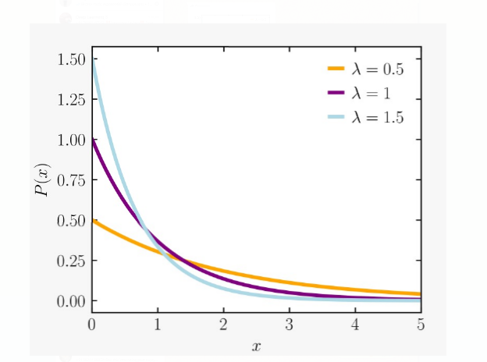

PROPERTIES:
Probability density function:
The probability density function(pdf) of an exponential distribution is
ƒ(x,λ)=
Here λ > 0 is the parameter of the distribution, often called the rate parameter.

Slide 4
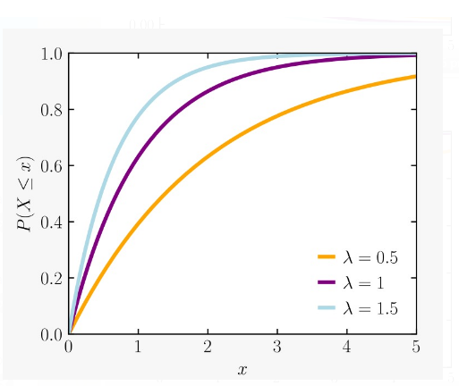

CUMULATIVE DISTRIBUTION FUNCTION
The cumulative distribution function(cdf) is given by,
F(x,λ)=

Slide 5
MEMORYLESSNESS
The exponential distribution is memoryless because the past has no bearing on its future behavior.
P(X > s + t | X > t) = e –λs
This type of problem shows up frequently in queuing systems where we are interested in the time between events.

Slide 6
EXAMPLES

Slide 7
Time Between Customers
The number of minutes between customers who enter a certain shop can be modeled by the exponential distribution.
For example, suppose a new customer enters a shop every two minutes, on average. After a customer arrives, find the probability that a new customer arrives in less than one minute.
To solve this, we can start by knowing that the average time between customers is two minutes. Thus, the rate can be calculated as:
λ = 1/μ = ½ = 0.5
We can plug in λ = 0.5 and x = 1 to the formula for the CDF:
P(X ≤ x) = 1 – e^{-λx}
P(X ≤ 1) = 1 – e^{-0.5(1)}
P(X ≤ 1) = 0.3935
The probability that we’ll have to wait less than one minute for the next customer to arrive is 0.3935.

Slide 8
Time Between Earthquakes
The time between earthquake occurrences can be modeled using an exponential distribution.
For example, suppose an earthquake occurs every 400 days in a certain region, on average. After an earthquake occurs, find the probability that it will take more than 500 days for the next earthquake to occur.
To solve this, we start by knowing that the average time between earthquakes is 400 days. Thus, the rate can be calculated as:
λ = 1/μ= 1/400 = 0.0025
We can plug in λ = 0.0025 and x = 500 to the formula for the CDF:
P(X ≤ x) = 1 – e^{-λx}
P(X ≤ 500) = 1 – e^{-0.0025(500)}
P(X ≤ 500) = 0.7135
The probability that we’ll have to wait less than 500 days for the next earthquake is 0.7135.
Thus, the probability that we’ll have to wait more than 500 days for the next earthquake is 1 – 0.7135 = 0.2865.

Slide 9


SOME RELATED DISTRIBUTIONS OF EXPONENTIAL DISTRIBUTION
If and poisson(X) then,
Y (geometric distribution).
If X then |X − μ| ~ Exp (β).
If X ~ Pareto (1, λ) then log(X) ~ Exp(λ).

Slide 10
APPLICATION OF EXPONENTIAL DISTRIBUTION
Reliability Theory
Model Situations
Queuing Theory
Generating Exponential Variates

Slide 11
REAL LIFE DATA ANALYSIS

Slide 12
SELECTED DATA The data set reported by Efron21 represent the survival times of a group of patients suffering from Head and Neck cancer disease and treated using a combination of radiotherapy and chemotherapy (RT+CT)
12.20 | 23.56 | 23.74 | 25.87 | 31.98
37 | 41.35 | 47.38 | 55.46 | 58.36
63.47 | 68.46 | 78.26 | 74.47 | 81.43
84 | 92 | 94 | 110 | 112
119 | 127 | 130 | 133 | 140
146 | 155 | 159 | 173 | 179
194 | 195 | 209 | 249 | 281
319 | 339 | 432 | 469 | 519
633 | 725 | 817 | 1776

Slide 13
DATA VISUALIZATION ( These values represent survival time of patients)
Parameter estimate=λ=0.0044746733
Mean=1/λ=223.48= standard deviation
Median =128.50
Mode=0 (mode of exponential distribution)
1st quartile =67.21
3rd quartile=219.00
Quartile Deviation=143.105

Slide 14
APPLICATIONS
The exponential distribution has been fitted to a real lifetime data to test its goodness of fit.
METHEDOLOGY:
Graphical representation of data.
Q-Q Plot for testing the goodness of fit.
Kolmogorov- Smirnov test

Slide 15
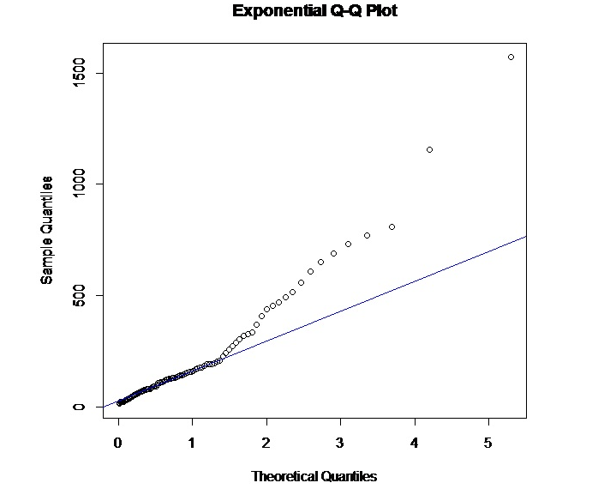
Q-Q PLOT
Here, through the graph we can observe that data is exponentially distributed

Slide 16
Testing of hypothesis, H0:data is a good fit of exponential distribution H1:data isn’t a good fit exponential distribution Result: D = 0.15909 , p-value = 0.6394 ; p > 0.05 ; 0.6394 >0.05
KOLMOGOROV-SMIRNOV TEST (TESTING GOODNESS OF FIT)

Slide 17
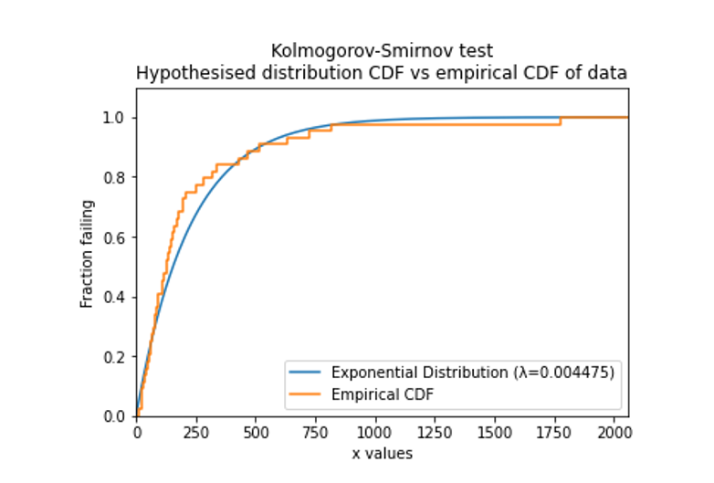

Slide 18
CONCLUSION:
From the above result we get to know that P-Value >0.05
Therefore, we do not reject our null hypothesis,
i.e., H0:data is a good fit of exponential distribution is accepted.

Slide 19
1. Wikipedia 2. Biometric & Biostatistics International Journal
REFERENCES

Slide 20
Thank you

